Slide 1
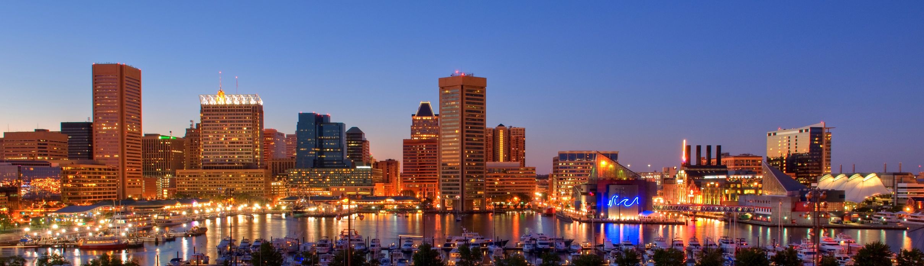
GREATER BALTIMORE BLACK CHAMBER OF COMMERCE PRESENTS:
WEBINAR
Mastering
Digital Marketing:
Strategies for Building a Strong Online Presence and Scaling Your Business
This Event Will Begin On:
Tuesday
From
April 23, 2024
06:00pm to 7:30pm
Cephas Sharp
Wednesday
May 08, 2024
Part 2
Free For Everyone
Co-Founder &
Digital Marketing Specialist
Part 3
May 22, 2024
Part 4
June 05, 2024
www.greaterbaltimoreblackchamber.org

Slide 2
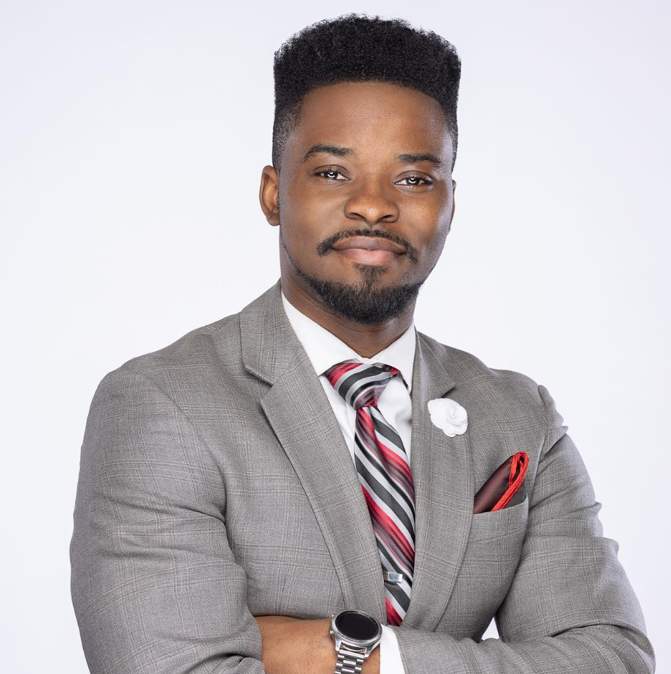
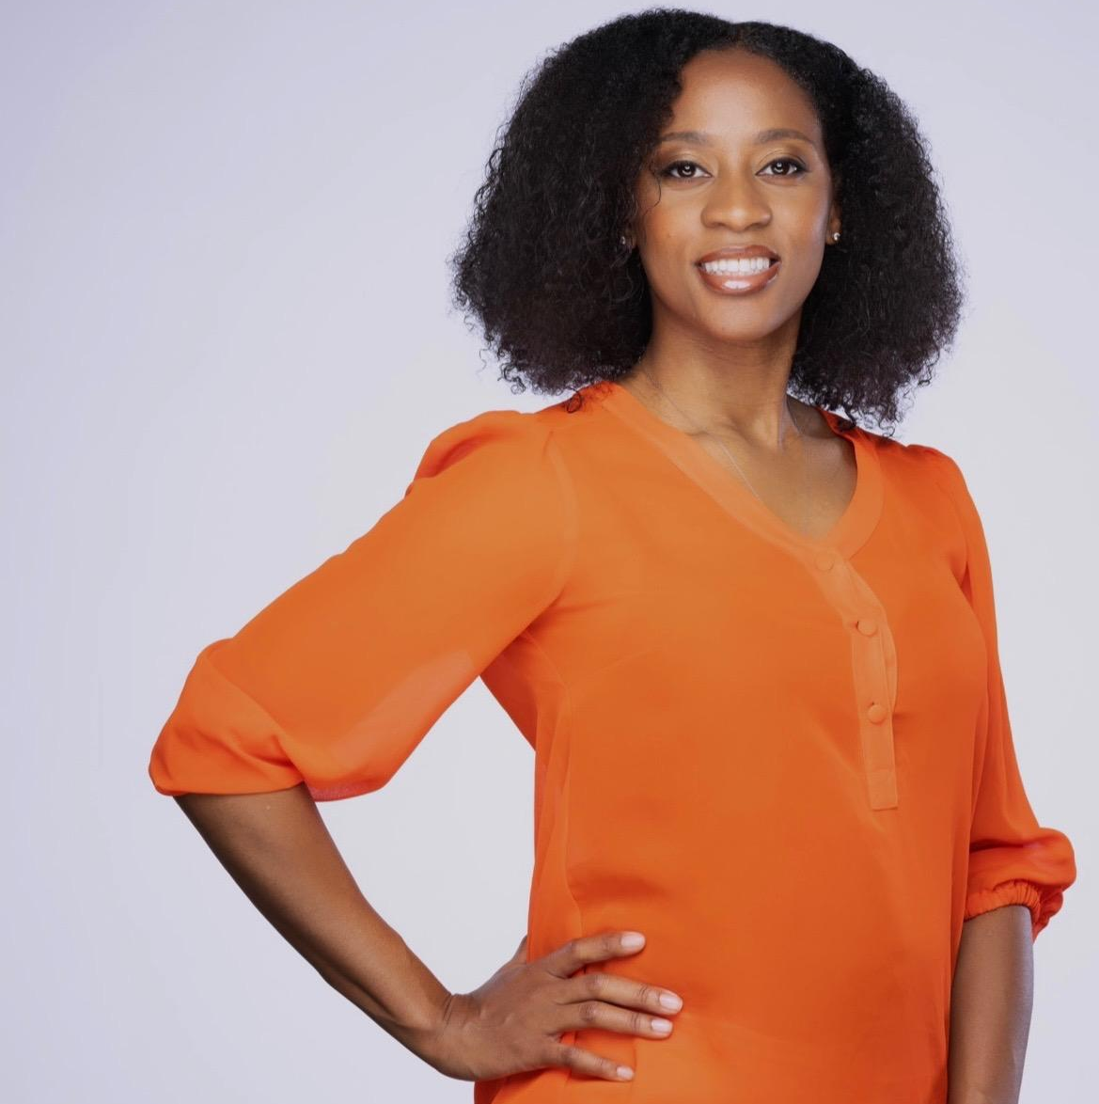
Cephas Sharp
Digital Marketing & Business Development
cephas.sharp@candjcreative.com
candjcreative.com
linkedin.com/in/cephassharp
Jaleesa Sharp
Digital Marketing & Social Media Coordinator
jaleesa.sharp@candjcreative.com
candjcreative.com
linkedin.com/in/jaleesasharp

Slide 3
Local business is more important than ever
82% of shoppers would rather support local business

Slide 4
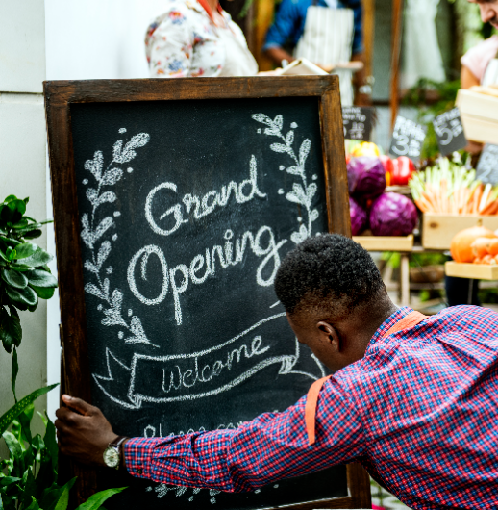
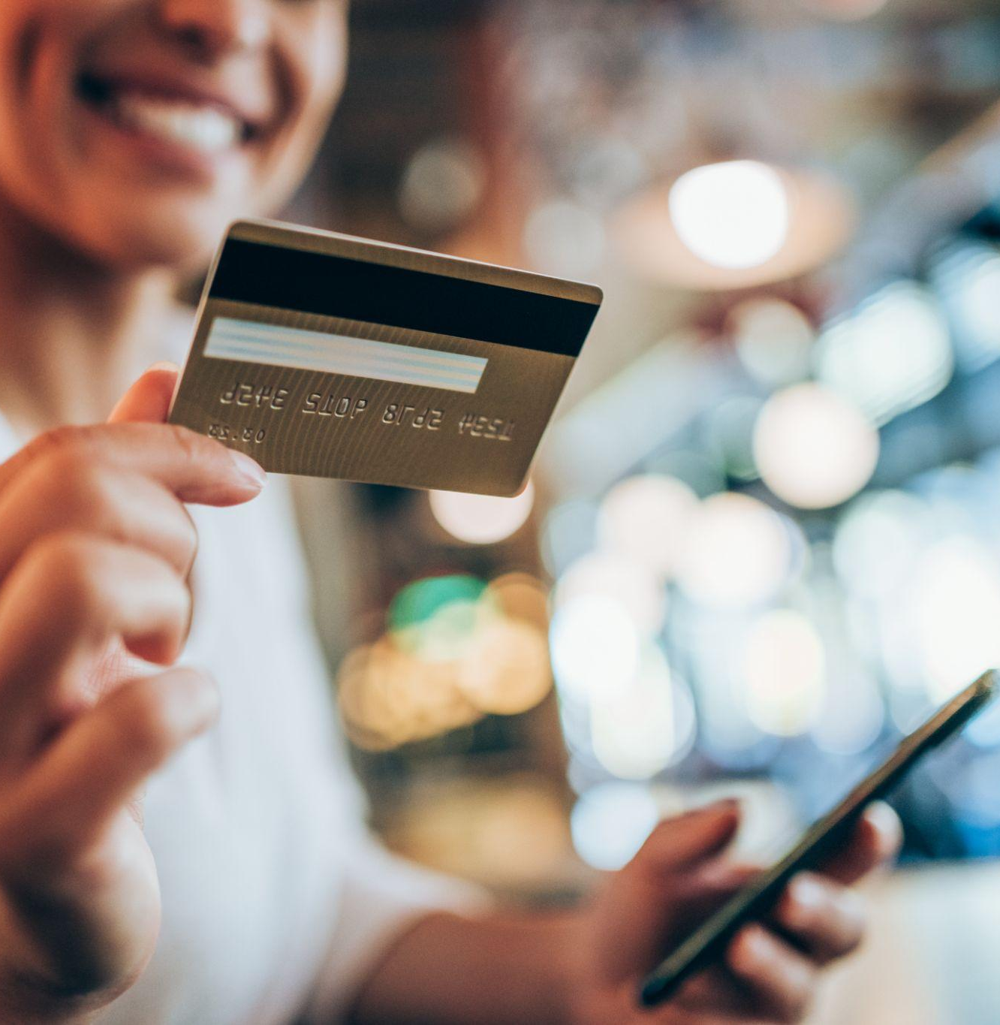
The strongest local businesses have a comprehensive digital marketing strategy
Raise brand awareness
Improve searchability
Create trust

Slide 5
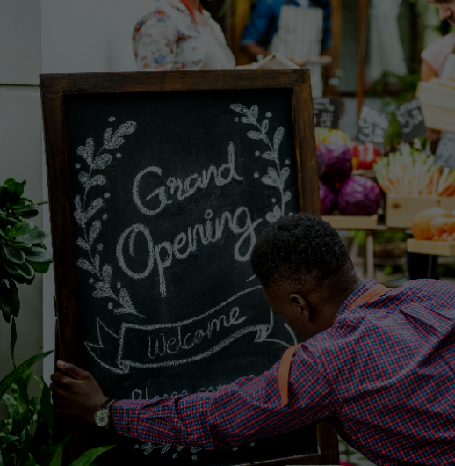
Many local businesses fail to manage their digital marketing strategy
Not top of mind
Not found in local search
Not trusted by consumers
More than 75% of customers prefer to buy from a brand they know
Local search accounts for more than 46% of Google searches
89% of consumers read reviews before buying

Slide 6
Strategy based on the whole customer journey is stronger than strategies based on channels in isolation

Slide 7
Customer Journey
Interest
Visibility
Trust
Sales
Experience
Awareness
Findability
Reputation
Conversion
$
Advocacy
Contributes to another customer’s journey
Stimulus
Digital Advertising
Traditional Advertising
Search
Online Listings Accuracy
Direct SEO
Research
Strong Positive Reviews
Relevant Reviews
Timely Responses
Social Presence
Purchase
Mobile Friendly Website
Easy Navigation
Simple Conversion
Great In Store Experience
Backing
Outlets To Share Experience
Social Communities
Customer Engagement

Slide 8
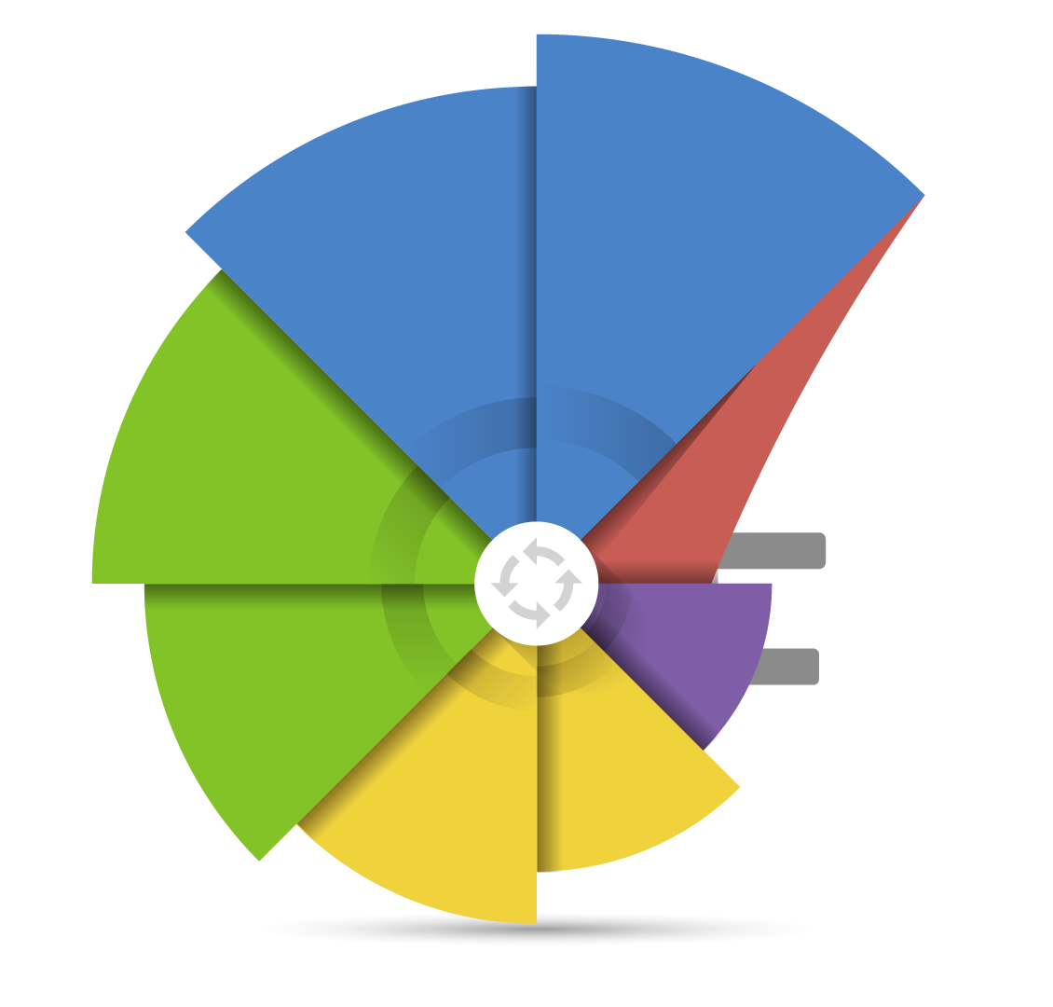
The circular customer journey
Awareness
Contributes to next customer decision…
Findability
Advocacy
Conversion
Reputation

Slide 9
Marketing for your competition
Business
A
Awareness
Findability
Reputation
Conversion
$
Advocacy

Slide 10
Marketing for your competition
Business
A
Awareness
Findability
Reputation
Conversion
$
Advocacy
Business
B
Awareness
Findability
Reputation
Conversion
$
Advocacy

Slide 11
How do we get there?

Slide 12
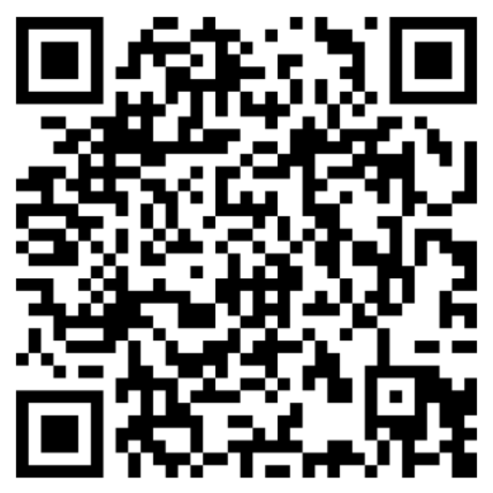
Webinar Agenda: Register Now!
Navigating The Basics of Digital Marketing And The Customer Journey
Crafting Impactful Content With The Help Of AI
Optimizing Google My Business For Enhanced Visibility & How To Get On The First Page Of Google
The Right Way To Leverage Google And Facebook For Business Growth
Notes:
With all this in mind, why don’t we take a moment to search for your services on Google and see what comes up?
Open up Google and perform a generic search related to the business. EG.) “plumber near me”, “lawyers in Springfield”, “best tacos”.
Make note of where they rank and their review scores. For best results, use a search term that you know they don’t rank highly for.

Slide 13
GREATER BALTIMORE BLACK CHAMBER OF COMMERCE PRESENTS:
Thank You!
This Event Will Begin On:
REGISTER NOW
Tuesday
From
April 23, 2024
06:00pm to 7:30pm
Cephas Sharp
Wednesday
May 08, 2024
Part 2
Free For Everyone
Co-Founder &
Digital Marketing Specialist
Part 3
May 22, 2024
Part 4
June 05, 2024
www.greaterbaltimoreblackchamber.org

